Slide 1

Computer Programming for Engineers
Week 13 Lecture 2
Nov. 24, 2022
Lecturer: Dr. Mohammad Mahdi Javidan
College of Engineering, Sungkyunkwan University
Fall Semester 2022

Slide 2
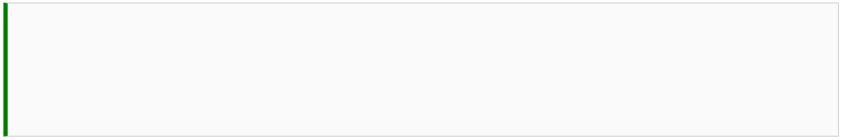




Some Useful Functions
Checking whether a character is a digit or not
Joining all elements of an indexed variable (list, string, tuples) with a separator.
College of Engineering, Sungkyunkwan University

Slide 3
Problem 4
Write the function getNumbers(str_1) which receives a string and returns the list of numbers inside that string.
Test case
College of Engineering, Sungkyunkwan University

Slide 4
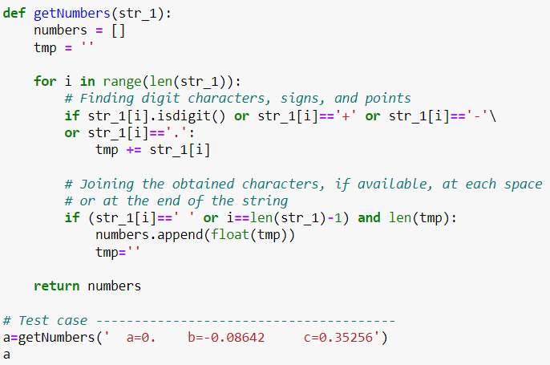
Problem 4
College of Engineering, Sungkyunkwan University

Slide 5
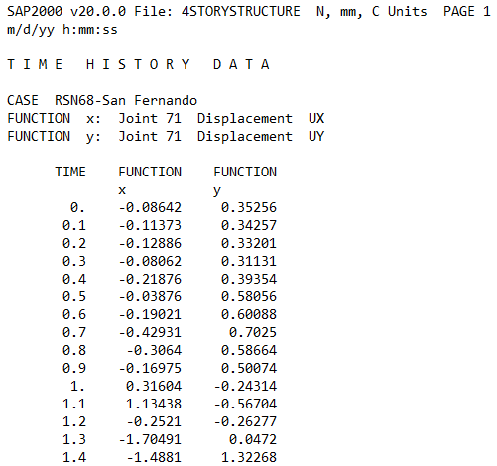
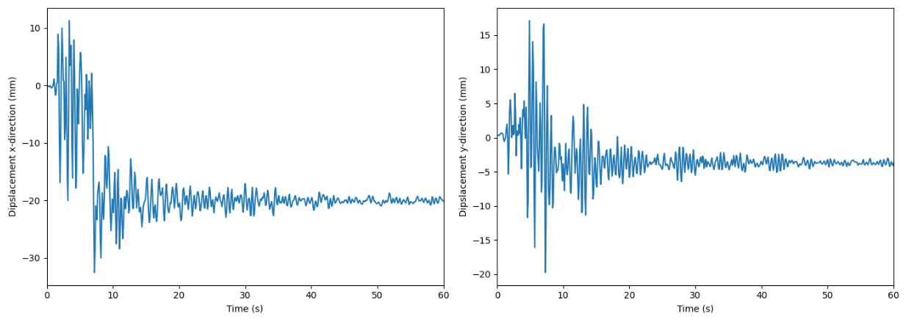
Problem 5
We have several output reports from a program and we want to plot them in Python. One file has been provided as an example. First thirteen lines are information and then there are three columns, first one is time, second and third columns are displacements in the x- and y-directions. Read the file in Python and plot the data against time in two subplots as shown below.
Test case
College of Engineering, Sungkyunkwan University

Slide 6
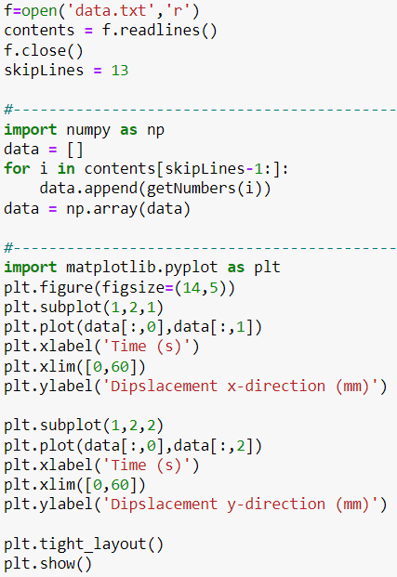
Problem 5
Reading the file
Skipping first 13 lines
Defining a numpy matrix using a nested list
Making a figure with two subplots
College of Engineering, Sungkyunkwan University

Slide 7


Problem 6
Write a function to swap the elements
Test case
b. Selection sort is an in-place comparison sorting algorithm which repeatedly finds the maximum element in the unsorted part and puts it at the end of that part. The algorithm is shown for a test case in the next slide. Write a function selection_sort(list_1) which returns the sorted list in the descending order using the selection sort algorithm.
College of Engineering, Sungkyunkwan University

Slide 8

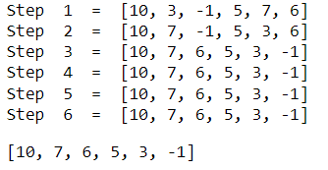
Problem 6
Test case
College of Engineering, Sungkyunkwan University

Slide 9
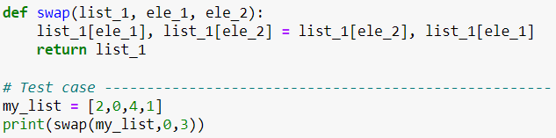
Problem 6
College of Engineering, Sungkyunkwan University

Slide 10
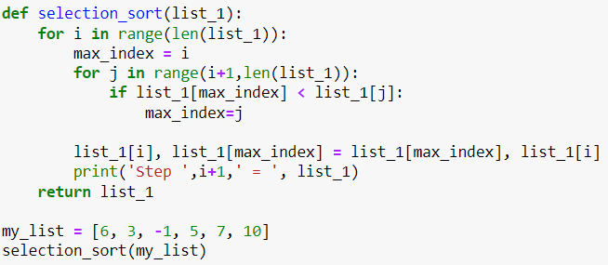
Problem 6
College of Engineering, Sungkyunkwan University

